Slide 1
Week 20
CVPR2023-Awards&Highlights

Slide 2
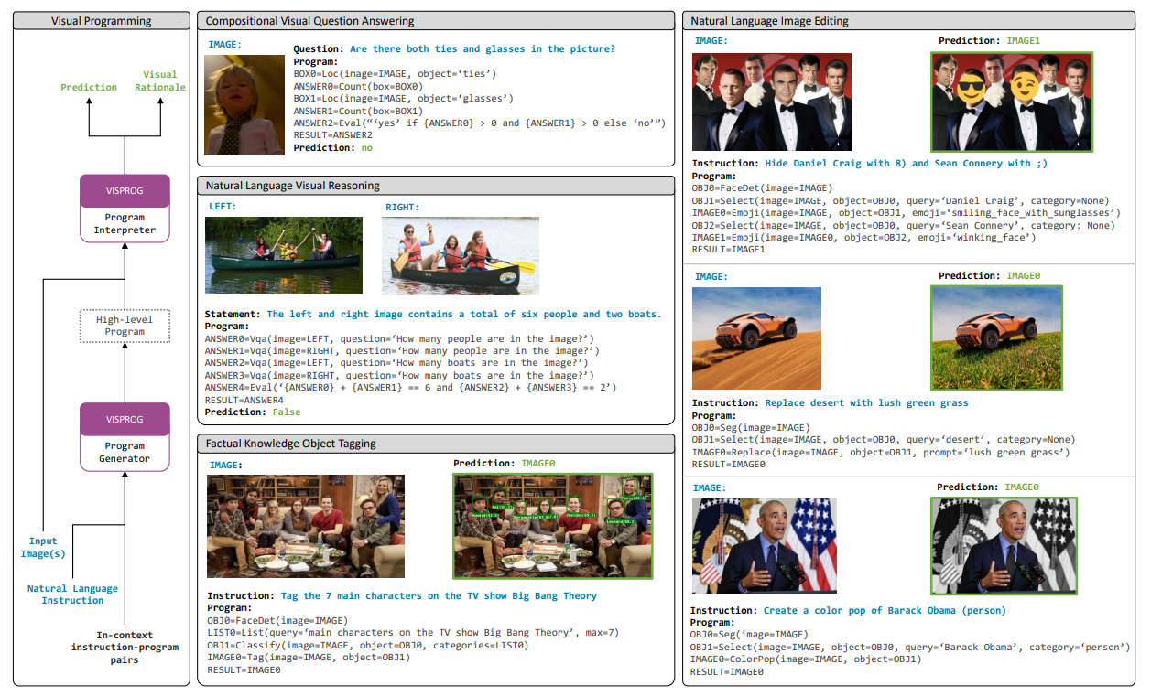
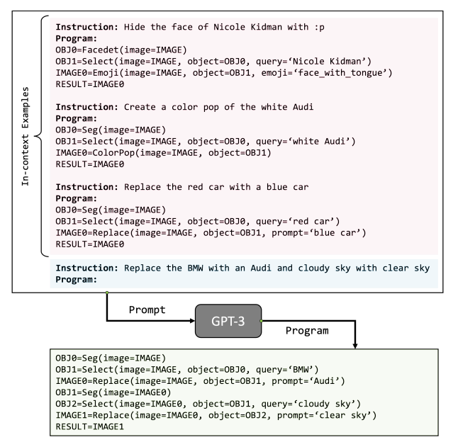
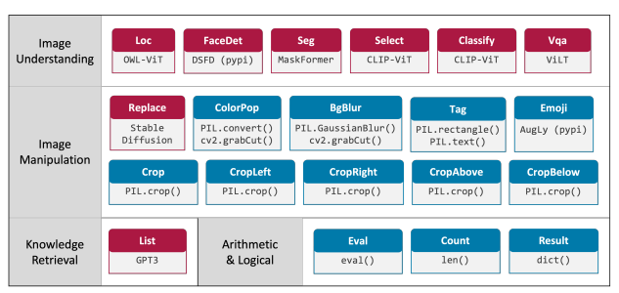
Visual Programming: Compositional visual reasoning without training

